Slide 1
Chapter 3 : Software Process and Other Models
Juthawut Chantharamalee
Curriculum of Computer Science
Faculty of Science and Technology, Suan Dusit University
Email: jchantharamalee@yahoo.com
URL: http://dusithost.dusit.ac.th/~juthawut_cha/home.htm

Slide 2
Outline of this presentation
The Software Process Model
Data Flow Diagrams
Petri Net Models
Object Models
Use Case Diagrams
Scenarios
Reference to Chapter 1 of “Software Engineering with Schaum’s Out Line”, McGraw-Hill, 2002.

Slide 3
Outline of this presentation (Cont.)
Sequence Diagrams
Hierarchy Diagrams
Control Flow Graphs
State Diagrams
Lattice Models
Reference to Chapter 1 of “Software Engineering with Schaum’s Out Line”, McGraw-Hill, 2002.

Slide 4
2.1 The Software Process Models
A software process model (SPM) describes the processes that are done to achieve software development. A software process model usually includes the following:
Tasks
Artifacts (files, data, etc.)
Actors
Decisions (optional)

Slide 5
The following are rules and interpretations for correct process models:
Two tasks cannot be connected by an arc. Tasks must be separated by artifacts.
A task is not executable until its input artifacts exist.
There are one or more start tasks and one or more terminal tasks.
All tasks must be reachable from the start task.
There is a path from every task to the terminal task.

Slide 6
Example
the software process model can describe what is supposed to happen. Prescriptive software process models can be used to describe the standard software development process. These can be used as training tools for new hires, for reference for uncommon occurrences, and for documenting what is supposed
to be happening.

Slide 7
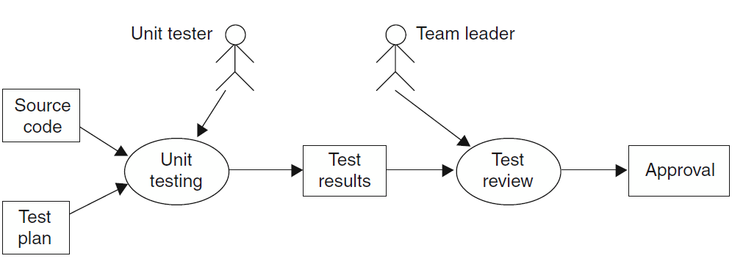
Example-1
Fig. 2-2. Process diagram for unit

Slide 8
Example-2
Fig. 2-2 Process model with decisions

Slide 9
2.2 Data Flow Diagrams
One of the most basic diagrams in software development is the data flow diagram. A data flow diagram shows the flow of the data among a set of components. The components may be tasks, software components, or even abstractions of the functionality that will be included in the software system. The actors are not included in the data flow diagram. The sequence of actions can often be inferred
from the sequence of activity boxes.

Slide 10
The following are rules and interpretations for correct data flow diagrams:
1. Boxes are processes and must be verb phrases.
2. Arcs represent data and must be labeled with noun phrases.
3. Control is not shown. Some sequencing may be inferred from the ordering.
4. A process may be a one-time activity, or it may imply a continuous
processing.
5. Two arcs coming out a box may indicate that both outputs are produced or that one or the other is produced.

Slide 11
Example-3
Fig. 2-3 Data flow for unit testing

Slide 12
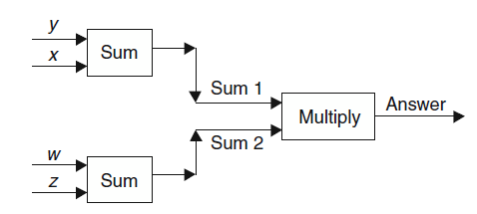
Example-4
Fig. 2-4 The calculation of the mathematical formula

Slide 13
2.3 Petri Net Models
The basic petri net model consists of condition nodes, arcs, event nodes, and tokens. If the input condition nodes for an event node all have tokens, then the event can fire, the tokens are removed from the input nodes, and tokens are placed on all of the output nodes of the firing position. The condition nodes
are usually represented by circles and the event nodes by horizontal lines or rectangles.

Slide 14
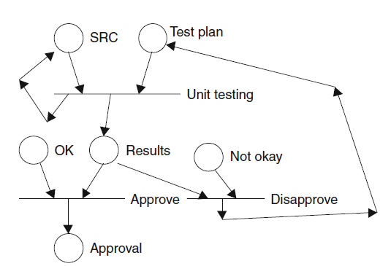
Example-5
Fig. 2-5 Petri net model

Slide 15
2.4 Object Models
Object models represent entities and relationships between entities. Each box represents a type of object, and the name, attributes, and the methods of the object
are listed inside the box. The top section of the box is for the name of the object, the second section is for the attributes, and the bottom section is for the methods.

Slide 16
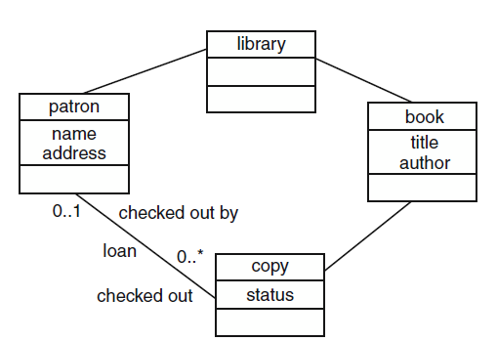
Example-6
Fig. 2-6 Object model of simple library

Slide 17
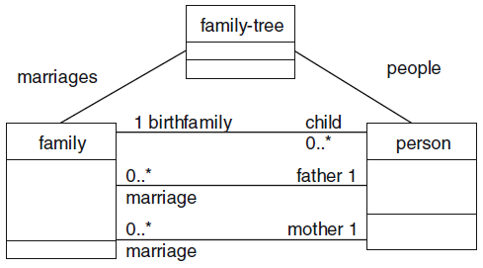
Example-7
Fig. 2-7 Family-tree object model

Slide 18
2.4.1 EXISTENCE DEPENDENCY
Existence dependency relationships are defined
as follows: A class (parent) can be associated with a lower class (child) if the lower (child) class only exists when the upper (parent) class exists and each instance of the lower (child) class is associated with exactly one instance of the upper (parent) class. This relationship and inheritance can be used to represent any problem domain.

Slide 19
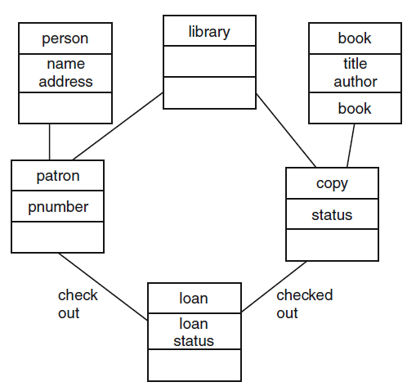
Example-8
Fig. 2-8 Library object model using ED

Slide 20
2.4.2 INSTANCE DIAGRAMS
Object diagrams represent types of objects. Thus, a boxlabeled ‘‘car’’represents the attributes and functions of all cars. Sometimes the relationships between instances of objects are not very clear in an object diagram. An instance diagram shows example instances of objects and may clarify the relationships.

Slide 21
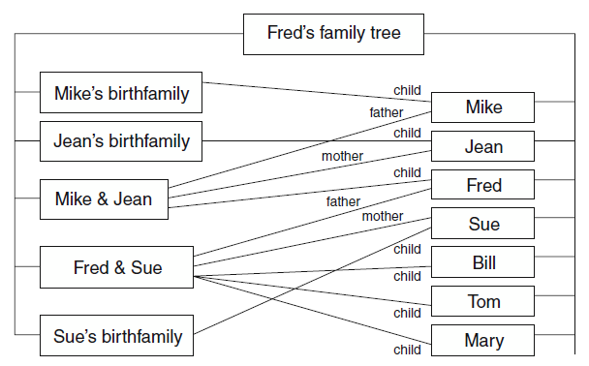
Example-9
Fig. 2-9 Instance diagram of Fred’s family tree

Slide 22
2.5 Use Case Diagrams
A use case diagram is part of the UML set of diagrams. It shows the important actors and functionality of a system. Actors are represented by stick figures and functions by ovals. Actors are associated with functions they can perform.

Slide 23
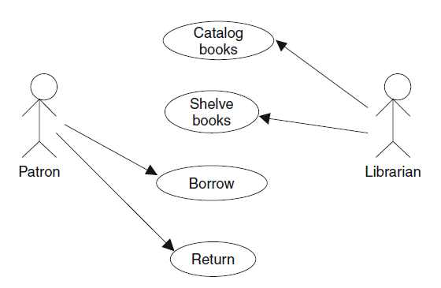
Example-10
Fig. 2-10 Use case for simple library

Slide 24
2.6 Scenarios
A scenario is a description of one sequence of actions that could occur in this problem domain.
EXAMPLE 2.11
Write a scenario for the library problem. Fred, a patron, goes to the library and checks out a book. Two months later, he brings the overdue library book back to the library.

Slide 25
2.7 Sequence Diagrams
A sequence diagram is part of the UML set of diagrams. The diagram has vertical lines, which represent instances of classes. Each vertical line is labeled at the top with the class name followed by a colon followed by the instance name.

Slide 26
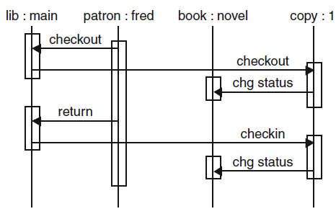
Example-11
Fig. 2-11 Sequence diagram for checkout scenario

Slide 27
2.8 Hierarchy Diagrams
A hierarchy diagram shows the calling structure of a system. Each boxrepresents a
function. A line is drawn from one function to another function if the first function can call the second function. All possible calls are shown. It is not one of the UML set of diagrams and is often not used in objectoriented development. However, it can be a very useful diagram to understand the dynamic structure of a system.

Slide 28
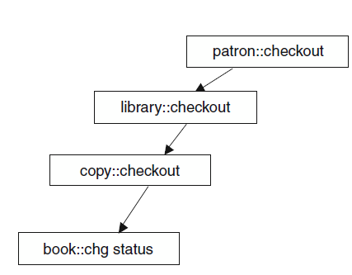
Example-12
Fig. 2-12 Hierarchy diagram

Slide 29
2.9 Control Flow Graphs
A control flow graph (CFG) shows the control structure of code. Each node (circle) represents a block of code that has only one way through the code. That is, there is one entrance at the beginning of the block and one exit at the end. If any statement in the block is executed, then all statements in the block are executed. Arcs between nodes represent possible flows of control. That is, if it is possible that block B is executed, right after block A, then there must be an arc from block A to block B.

Slide 30
The following are rules for correct control flow diagrams:
1. There must be one start node.
2. From the start node, there must be a path to each node.
3. From each node, there must be a path to a halt node.

Slide 31
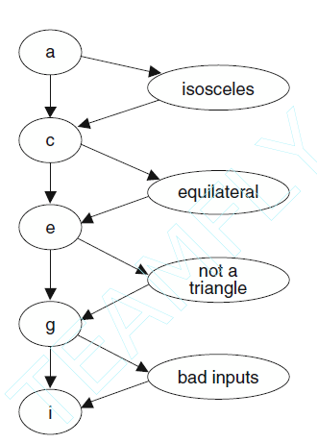
Example-13
Fig. 2-13 Control flow graph for triangle program.

Slide 32
2.10 State Diagrams
The state of a machine or program is the collection of all the values of all the variables, registers, and so on. A state diagram shows the states of the system and the possible transitions between these states.

Slide 33
The following are rules for correct state diagrams:
1. There is one initial state.
2. Every state can be reached from the initial state.
3. From each state, there must be a path to a stop state.
4. Every transition between states must be labeled with an event that will
cause that transition.

Slide 34
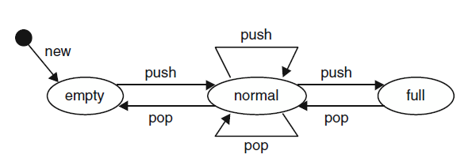
Example-14
Fig. 2-14 State diagram for a fixed-size stack

Slide 35
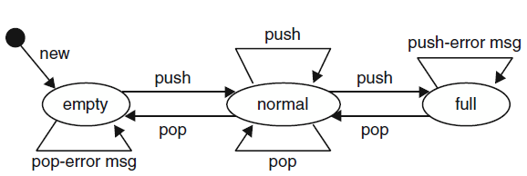
Example-15
Fig. 2-15 State diagrams showing error transitions

Slide 36
2.12 Lattice Models
A lattice is a mathematical structure that shows set relationships. Although not used in software development very often, it is being used more to show the relationships between sets of functions and attributes.

Slide 37
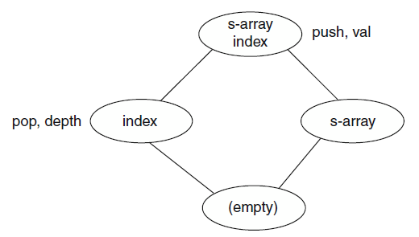
Example-16
Fig. 2-16 Lattice model for stack example

Slide 38
Chapter 3: The End (Any Question?)

